Slide 1

PRIVACY PRESERVING AND COLLABORATIVE TAGGING WITH FACET CONTROL
STUDENT NAME
ASWINI.G
JEYANTHI.M
SHOBANA.J.B
SRISANTHANALAKSHMI.G
PROJECT GUIDE NAME
Mrs.S.UMA

Slide 2
ABSTRACT:
Getting back to previously viewed web pages is a common yet uneasy task for users due to the large volume of personally accessed information on the web.
The main aim of this project is to classify resources, protect user privacy while tagging resources and searching and to enhance web access functionalities like content filtering based on preferences specified by end users.
The purpose of collaborative tagging is to loosely classify resource based on end - user’s feedback, expressed in the form of free-text labels (i.e., tags).

Slide 3
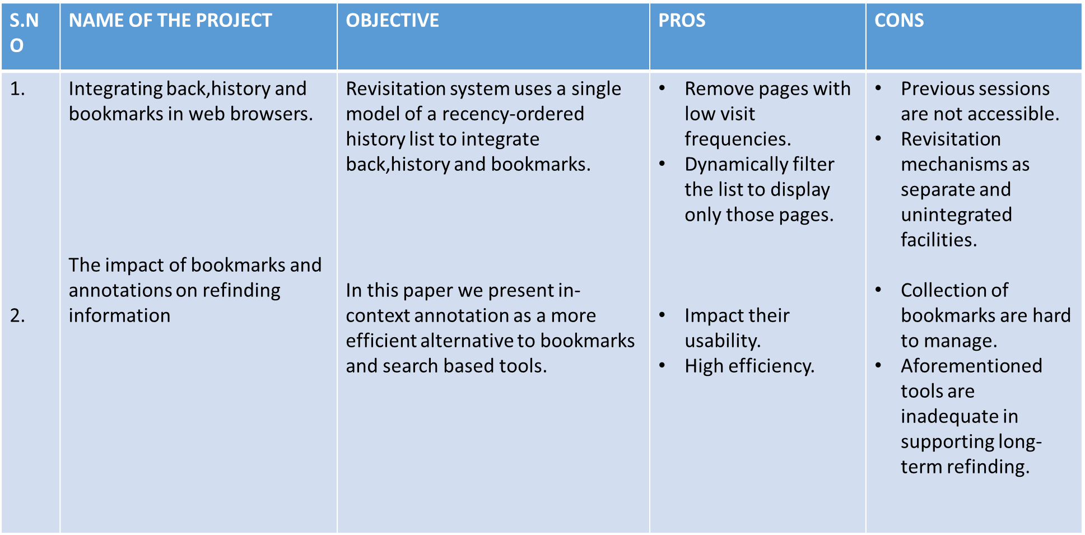
LITERATUTE SURVEY:

Slide 4
S. No | Name of the paper | objective | pros | cons
3 | Utilizing Re-finding for personalized Information Retrieval | In this we explore re-finding for personalized search. We propose several re-ranking methods to utilize the prediction . Using re-finding prediction we can improve performance. | It might improve the retrieval quality and the search engine click through rates. Regression models is to predict re-finding based on users search history. | Only by testing our method we will have a better indication of how much re-finding can be used to improve ranking.

Slide 5
S. No | Name of the paper | objective | pros | cons
4 | Contextual web History : using Visual and Contextual Cues Web Browser History | In this paper, we present the design and evaluation of Contextual Web History (CWH), a novel browser history implementation which improves the visibility of the history feature and helps people find previously visited web pages. | Auto-completion is applicable for commonly used URLs. Testing CWH on large personal histories gets qualitative feedback from users and quantitative feedback from user logs | Back button support only short term revisitation.

Slide 6
S.NO | NAME OF THE PAPER | OBJECTIVE | PROS | CONS
5 | Large scale query log analysis of Re-Finging | Refinding queries are shorter. It happens at the beginning of the session than the end and improves the search experience | Refinding queries tended to be better than the previous queries that are used to research a given URL. It converged on a high quality query. | Refinding queries results only when tags are useful.

Slide 7
S. No | Name of the paper | Objective | Pros | Cons
6 | Search Panel: Framing complex search needs | In this paper, we designed and built search panel, a chrome browser extension to represents the retrieved documents that can be used for sense-making, navigation, an re-finding documents. Search panel appears to have been primarily used for complex information needs, in search session with long duration and high number of queries. | It aimed to create a light weight method for presenting data to the user throughout search process. We built a tool that can be used with any any of the search engines. e.g. Google, Yahoo, Bing | Complex version had more queries and actions so it takes longer session duration.

Slide 8
S. No | Name of the paper | Objective | Pros | Cons
7 | Improving recall with contextual search | It present a new interaction technique , Pivoting , that allows users to search for contextually related activities and find a target piece of information. We present a new personal annotation method called Time Marks to support contextual recall and pivoting process. | It improves the quality and speed of recall. Quicker to identify websites. | You pivot is not intended to be the perfect incarnation of contextual search.

Slide 9
EXISITING SYSTEM:
A number of techniques and tools like bookmarks, history tools, search engines, metadata annotation and exploitation, and contextual recall systems have been developed to support personal web revisitation.
The collection of end-users private information stored by social services, is now recognized as a privacy threat. users profiles, containing sensitive information, such as health-related information, political preferences, salary or religion.
It could be possible to correlate the account of a user with other accounts he or she may have at different services, which would imply gaining far more precise information about the user profile.

Slide 10
PROPOSED SYSTEM:
Protects user privacy to a certain. It make a user profile show bias toward certain categories of interest.
Tag suppression is a technique that has the purpose of preventing privacy attackers from profiling users interests on the basis of the tags that specify.
Resource recommendation, provides relevant resources based on user recommendation.(your own).Or the server can recommend it(from server).
Parental control concerns whenever a group user requests resource. Group owner give privilege to access resources. We also provide Facet block for particular user.

Slide 11
SOFTWARE REQUIREMENTS:
Windows 7(32 bit) and above
JDK 1.6
Tomcat 6.0
MySql 5.0
WordNet 2.1

Slide 12
HARDWARE REQUIREMENTS:
Hard Disk : 40GB and above
RAM : 2GB and above
Processor : P IV and above
INTERNET Dongle : 1
(Note: Internet connectivity must )

Slide 13
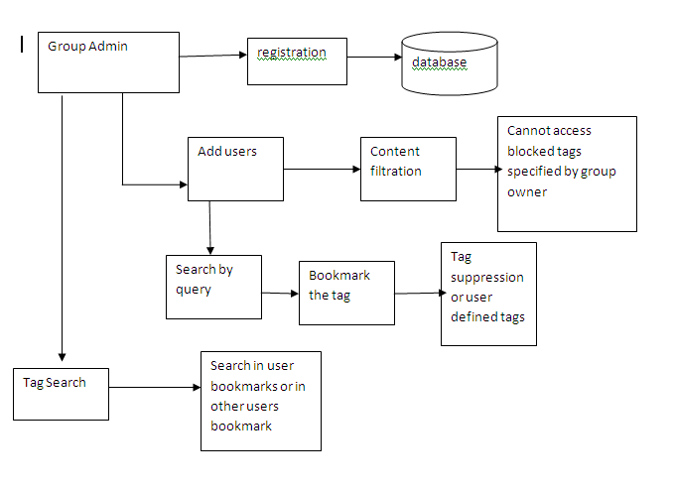
ARCHITECTURE DIAGRAM:
ARCHITECTURE DIAGRAM:

Slide 14
ALGORITHM/METHODOLOGY:
The algorithm used in this project is NATURAL LANGUAGE PROCESSING algorithm.
NLP:
NLP is the way for computers to analyse and understand and derive meaning from human language in a smart and useful way.
By utilizing NLP developers can organize and structure knowledge to perform task such as a automatic summarization, translation, relationship extraction, speech recognition and topic segmentation.

Slide 15
NLP algorithm are typically based on machine learning algorithm.
Instead of hand coding large sets of rules, NLP can rely on machine learning to automatically learn these rules by analysing a set of examples like a book.

Slide 16
J2EE:
It is a combination of servlet and JSP combination.
Servlet is used to view the backend process.
JSP is used to view the front end process.
JSP is same as like the html file.

Slide 17
METHODOLOGY:
COLLABORATIVE TAGGING:
It describes the process by which many users add metadata in the form of keywords to shared content.
CONTENT FILTERING:
A web filter is a program that can screen an incoming web page to determine whether some or all of it should not be displayed to the user.

Slide 18
NOVELTY:
Facet search is used to list the available category to a specific person.
Parental control is used to block a whole category and block a specific tag for
particular user.
Group owner or admin enable a Web Filter for group users by granting them only
to contents specified by group owner.

Slide 19
FEASIBILITY STUDY:
ECONOMIC FEASIBILITY:
This study is carried out to check the economic impact that the system will have on the organization.
The expenditures must be justified. Thus the developed system relies within the budget and this was achieved because most of the technologies used for freely available.
Only the customized products had to be purchased. So this can be easily affordable for people of different environment.
TECHNICAL FEASIBILITY:
Earlier no system existed to the needs of ‘parental control’. The current system developed is technical feasible.
The proposed project requires less technical resources for execution as the existing SQL is used as database and tomcat server is used as it doesn’t require internet connectivity.

Slide 20
Therefore it provides the technical guarantee of accuracy ,reliability and security.
OPERATIONAL FEASIBILITY:
The aspect of study is to check the level of acceptance of the system by the user.
This system requires knowledge on using software and how it works for the administrator to monitor the system.
The user must have basic knowledge on search resources in the web and if they likes it they can bookmark interested link.
The system proposed would be which the parental control ,that is it can be use to block a specific tag or a specific category is made as heart of this proposed project such that minimal knowledge on the innovative technologies is needed.

Slide 21
MODULE SPLITUP:
Add Group User
Search and Bookmark
Tag Suppression and Tag Recommendation
Parental Control

Slide 22
ADD GROUP USER:
In this module, Group owner has to register their details.
After successful registration, details are stored in database.
Group owner set username and password to all group users.
Using this username and password, user can view group owner’s profile, bookmarks etc.
Group users register their details.
At registration, group user has to provide username and password given by group owner, they restricts users to view only specified contents.

Slide 23
SEARCH AND BOOKMARK:
User can search resources in web according to their personal preferences.
List of websites displayed where user can view his/her interested links.
User can give access privileges to bookmarks.
If the bookmark is private, only the user can view.
If the bookmark is public, other users can view his/her bookmarks.

Slide 24
TAG SUPPRESSION AND TAG RECOMMENDATION:
User likes a link in web and bookmarks that link. User tag the bookmark. While tagging, user can give own tag or ask server to suggest tags.
Server provides suppressed tags where user can choose tag. In this way, user protects their privacy while tagging. All the bookmarking information will be stored in database.
If the user searches a tag, he/she can search in their bookmarks or in all bookmarks. If the link has multiple tags, user searched tag and other tags for that links will be displayed. Recommending users for the past 1 week links and tags.

Slide 25
PARENTAL CONTROL:
Group owner can add users for content filtration purpose. Group owner enable a web filter for group users by granting them access only to contents specified by group owner. Group owner denote which resources is un/safe.
By checking the available tag categories, group owner blocks the tags for users. Group user can access the tags giving username and password.
Group user has restrictions only in Tag Search. All the other services, group user can access (Search and bookmark, Add bookmark). If any one of the facet is blocked to particular user, then he cannot access (Search, Bookmark, and Tag) that facet.

Slide 26
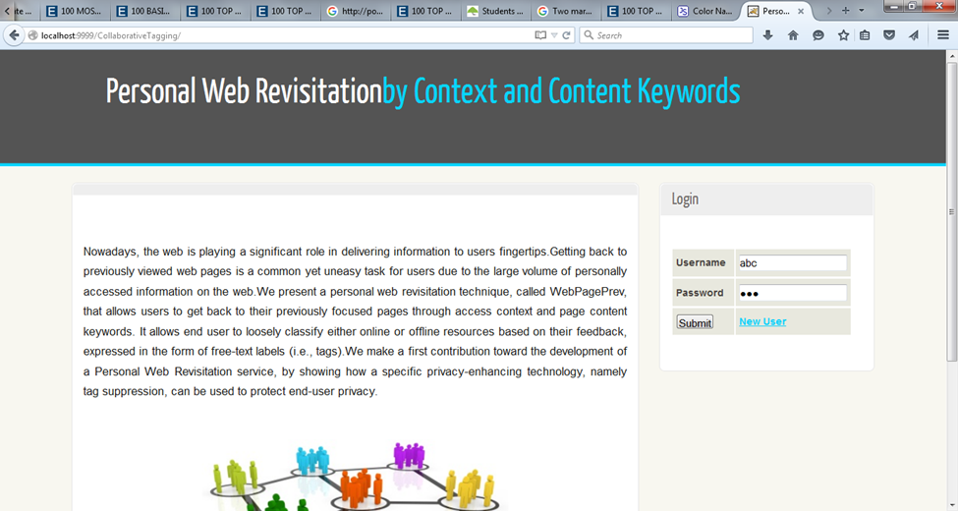
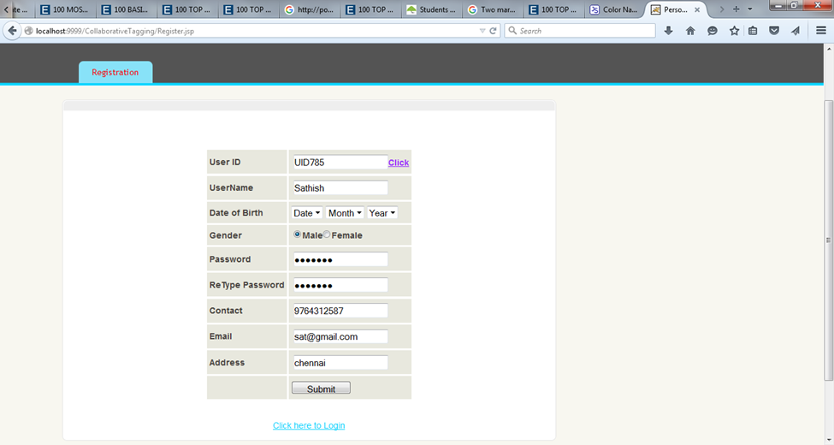
SNAPSHOT:

Slide 27
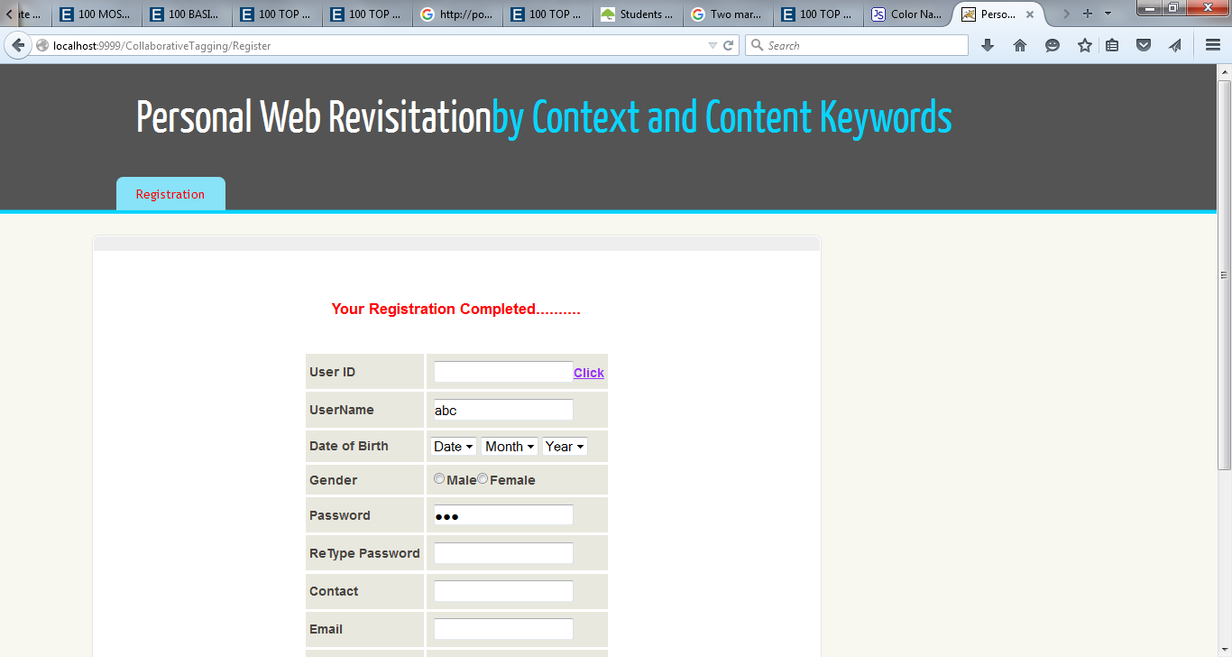


Slide 28
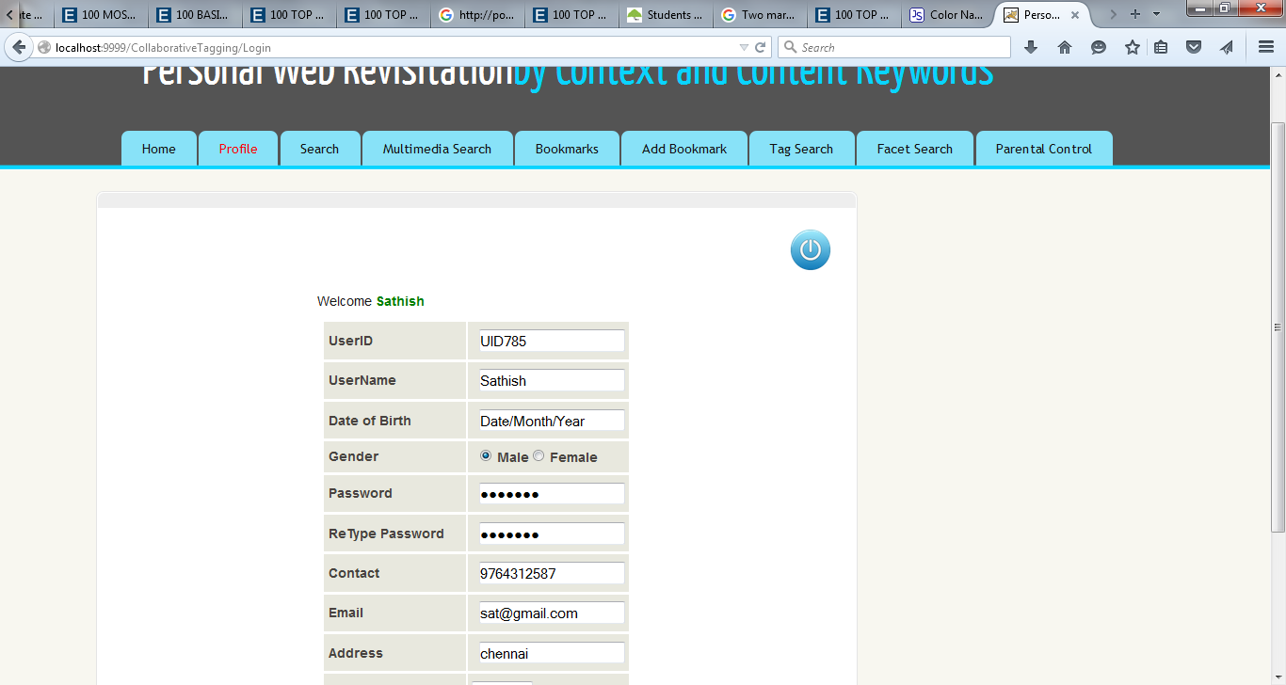
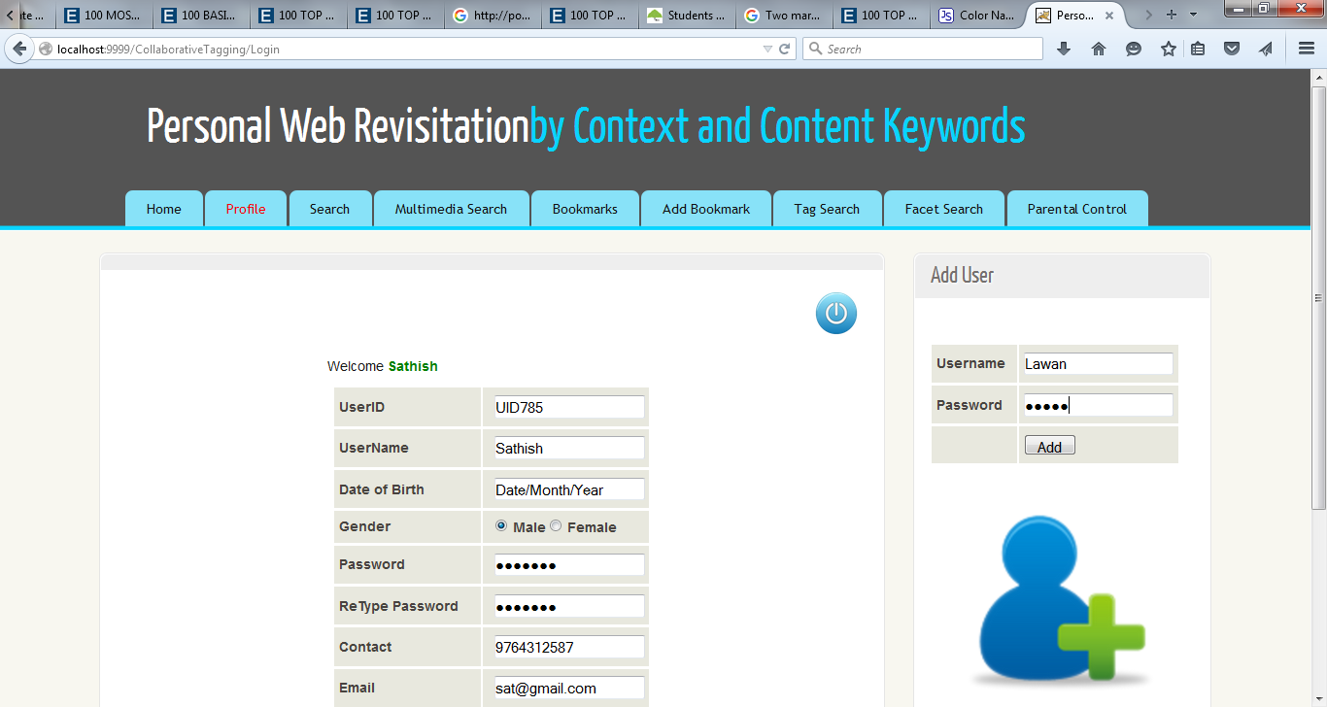

Slide 29
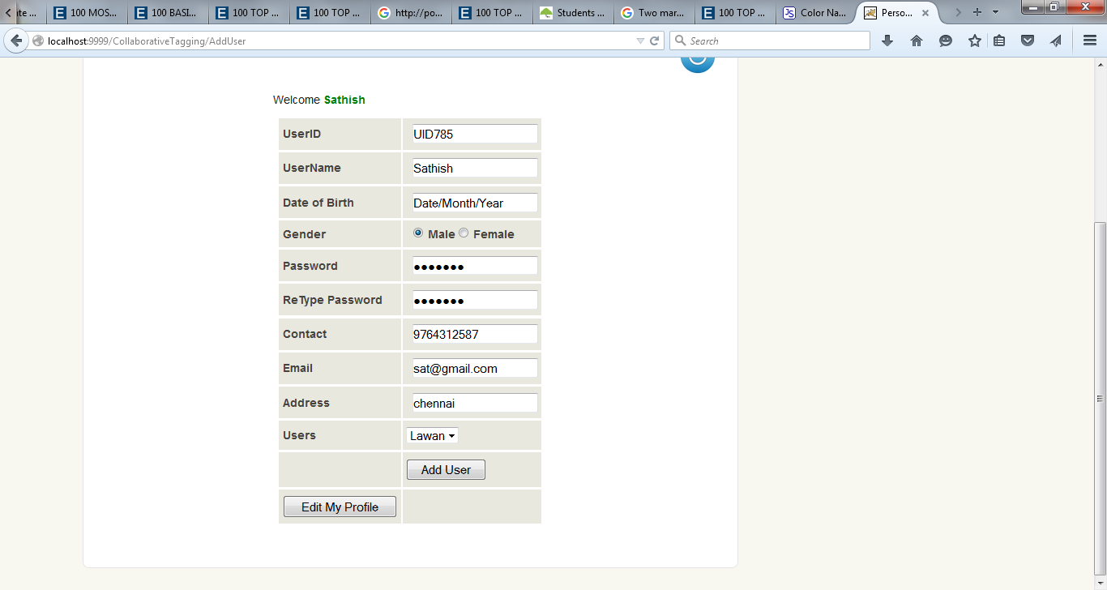
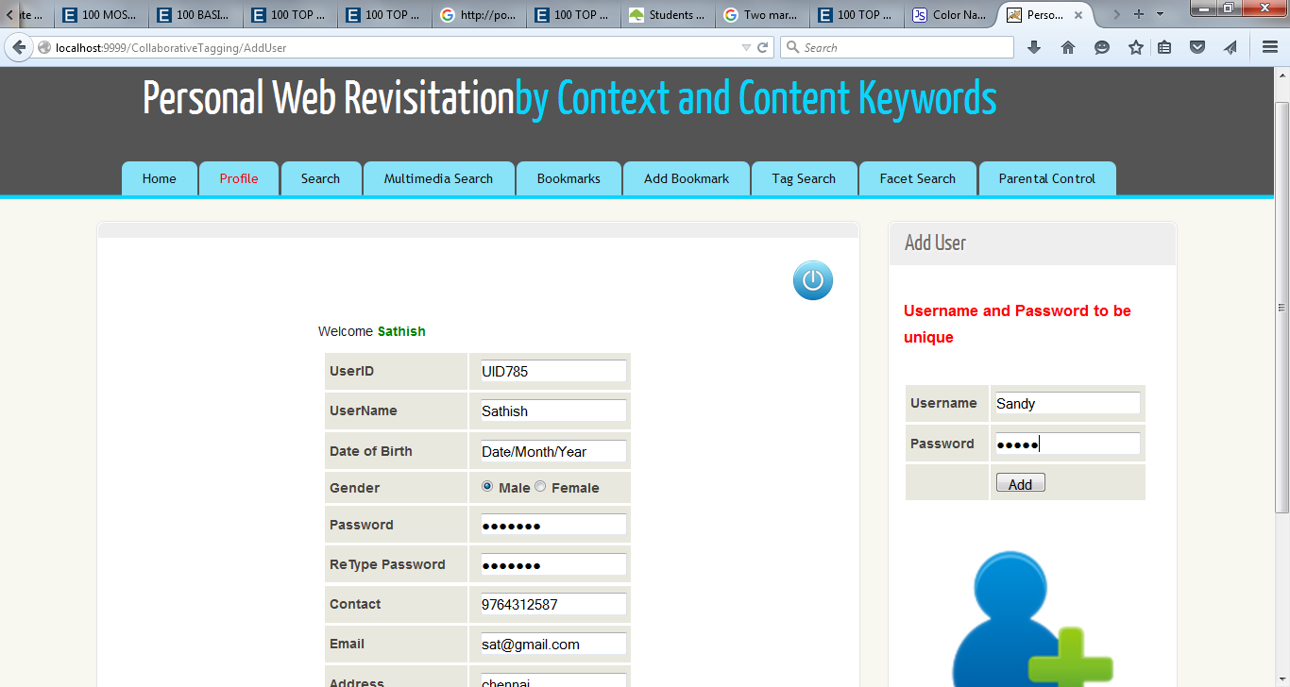

Slide 30
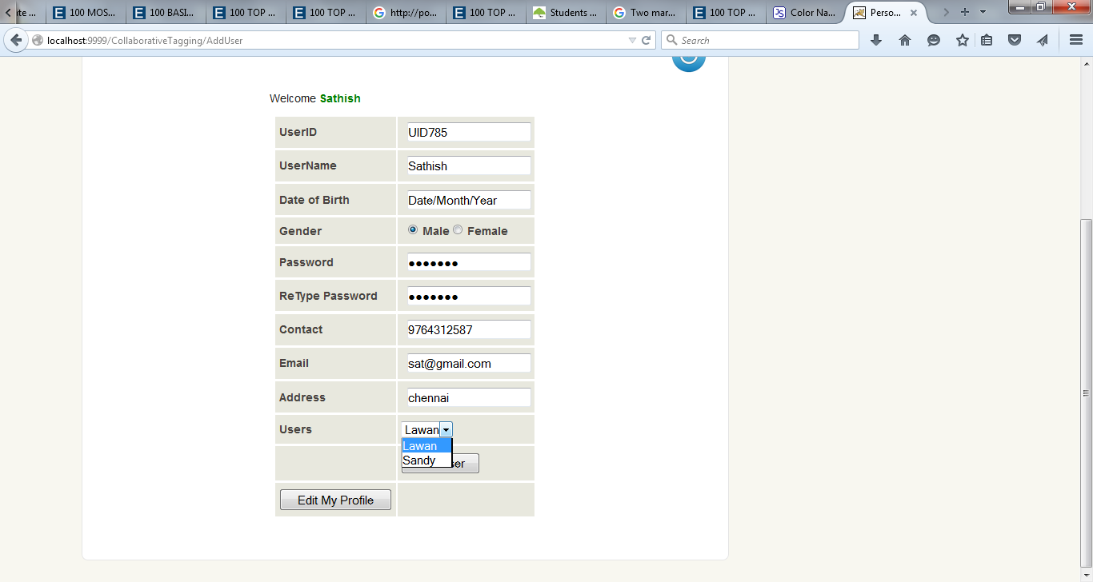

Slide 31
CONCLUSION
In collaborative tagging, users tag resources on the web according to their personal preferences.
Users therefore contribute to describe and classify those resources but this is inevitably at the expense of revealing their profile.
This helps to view users profile and collect user’s information.
Collaborative tagging is currently an extremely useful for online services.
Although the collaborative tagging is mainly used to support tag-based resource discovery and browsing, it could be exploited for other purposes.
One of these potential applications is the provision of web access functionalities such as content filtering and discovery.

Slide 32
FUTURE ENHANCEMENT
Two key scenarios, parental control and resource recommendation.
Since we are not aware of similar experimental studies, we believe that what reported in this paper can be useful to evaluate further future development in the area.
Future work includes the development of a full prototype for the experimented system and its testing and use in further scenarios.

Slide 33
REFERENCES:
1. P. Mika, “Ontologies Are Us: A Unified Model of Social Networks and Semantics,” Proc. Int’l Semantic Web Conf. (ISWC ’05), Y. Gil, E. Motta, V. Benjamins, and M. Musen, eds., pp. 522-536, 2005.
2. X. Wu, L. Zhang, and Y. Yu, “Exploring Social Annotations for the Semantic Web,” Proc. 15th Int’l World Wide Web Conf. (WWW), pp. 417-426, 2006.
3. B. Markines, C. Cattuto, F. Menczer, D. Benz, A. Hotho, and S.Gerd, “Evaluating Similarity Measures for Emergent Semantics of Social Tagging,” Proc. 18th Int’l Conf. World Wide Web (WWW),pp. 641-650, 2009.
4. C. Marlow, M. Naaman, D. Boyd, and M. Davis, “HT06,Tagging Paper, Taxonomy, Flickr, Academic Article, to Read,” Proc. 17th Conf. Hypertext and Hypermedia(HYPERTEXT),pp. 31-40, 2006.
5. B. Carminati, E. Ferrari, and A. Perego, “Combining Social Networks and Semantic Web Technologies for Personalizing Web Access,” Proc. Fourth Int’l Conf. Collaborative Computing: Networking, Applications and Worksharing, pp. 126-144, 2008.

Slide 34
6. R. Gross and A. Acquisti, “Information Revelation and Privacy in Online Social Networks,” Proc. ACM Workshop Privacy Electronic Soc. (WPES), pp. 71-80, 2005.
7. S.B. Barnes, “A Privacy Paradox: Social Networking in the United States,” First Monday, vol. 11, no. 9, Sept. 2006.
8. J. Parra-Arnau, D. Rebollo-Monedero, and J. Forne´, “A Privacy- Preserving Architecture for the Semantic Web Based on Tag Suppression,” Proc. Seventh Int’l Conf. Trust, Privacy, Security, Digital Business (TrustBus), pp. 58-68, Aug. 2010.
9. J. Voß, “Tagging, Folksonomy & Co - Renaissance of Manual Indexing?” Computer Research Repository, vol. abs/cs/0701072, 2007.
10. G. Adomavicius and A. Tuzhilin, “Toward the Next Generation of Recommender Systems: A Survey of the State-of-the-Art and Possible Extensions,” IEEE Trans. Knowledge Data Eng., vol. 17,no. 6, pp. 734-749, June 2005.

